Slide 1
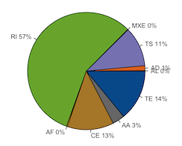
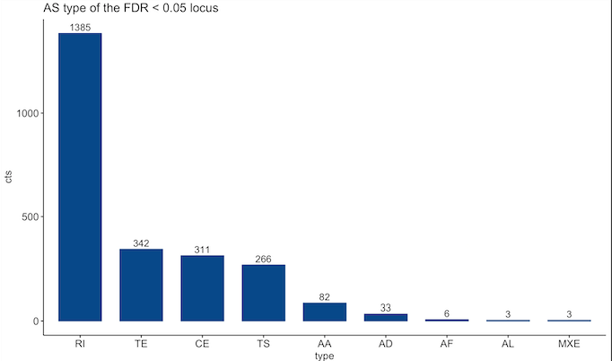
FASTQ files (raw reads)
QC
Trimming
Whippet
IRfinder
rMATS
Build ref index
Alignment
Build ref index
Alignment
Build ref index
Alignment
PSI results for each sample
Pool and contrast PSI
14 VS CTRL & 89 VS CTRL
Filter:
absDeltaPSI > 0.1
Probability > 0.9
PSI_KD > 0.1
Filter: remove known exon and minor isoform
FDR < 0.05
Filter:
FDR < 0.05
Significant events: intersection
Combine
Remove duplicates
PSI_KD = (PSI_14 + PSI_89)/2
deltaPSI = PSI_KD – PSI_CTRL
Add gene name
Final table
Pie chart
Bar plot

Slide 2
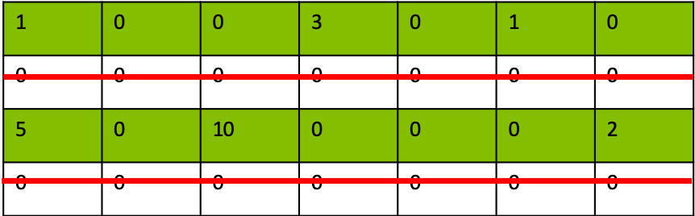
All the genes in the annotation file
Select the genes that have expression in ≥ 1 sample(s)
Get the set of unique introns from all the transcripts of each gene
Transcript a:
e.g.
Gene X
Transcript b:
Transcript c:
Transcript d:
Transcript e:
Keep the introns with length > 30
Total number: 335,436

Slide 3
Sig
(Significant)
1265
intersection
Sig SiSDE2-1
FDR < 0.05
Sig SiSDE2-2
remove known exon and minor isoform
Raw result of SiSDE2-1
All introns from expressive genes
(335,436)
Non-sig
(Not significant)
717
intersection
Non-sig SiSDE2-1
FDR ≥ 0.05
Non-sig SiSDE2-2
Raw result of SiSDE2-2
Non-AS
(No Alternative Splicing)
Non-AS-long
Non-AS-short (length < 75 quantile of the Sig events)

Slide 4
P < 0.05
KD_IRratio > WT_IRratio
IRfinder raw result
SiSDE2-1
Increased events
SiSDE2-2
SiSDE2-1
SiSDE2-2
SiSDE2 intersect
SiSDE2 union
TIA1
SRSF1
U2AF2
PCBP1
PCBP2
PTBP1
SRSF7
FUS
ENCODE data
from IRfinder
paper

